Slide 1

Speak Fluently & Confidently A2- Course 1

Slide 2
Session 4- Hobbies
Part 1-: Hobbies ( Listening)
Part 2: What would you say in the following
situations? ( More Idioms & collocations)
Part 3: Speaking Practice
https://befluent.me/

Slide 3
Session 4- Hobbies
Part 1-: Hobbies
( Listening )
https://befluent.me/

Slide 4
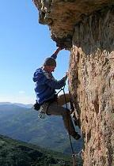

Lesson 4 – Hobbies
Today we’re going to talk about hobbies – the word “hobby” refers to an activity or interest that you do for pleasure or relaxation.
Conversation #1 – Talking about Hobbies
Ron and Eileen are getting to know each other on a first date. Listen to each of them ask and answer questions about their hobbies.
Ron: So what do you like to do in your free time? Do you have any hobbies?
Eileen: I’m really into rock climbing – I go up to the mountains every chance I can get.
Ron: Rock climbing?! Wow – how long have you been doing that?
Eileen: About 5 years. My college roommate introduced me to it. Unfortunately I’ve been super busy these days and I haven’t been able to do much climbing, so I go jogging to stay in shape. How about you – do you play any sports?
Ron: No, I’m not very athletic. I work out at the gym… once in a while! I spend a lot of time reading, and I’m interested in photography – but actually, my newest passion is gardening.
Eileen: Really? How’d you get into gardening?
Ron: I read an article that piqued my interest, about how home-grown vegetables are much healthier than what you buy in the supermarket – so I decided to give it a try.
Eileen: No kidding. Well, I don’t have a garden, but I have been getting into cooking and baking lately – I’m not very good at it, but it is fun to experiment!
Conversation Vocabulary & Phrases
Ron starts by asking Eileen about her hobbies. Here are a few different ways to ask this question:
"What are your hobbies?" / "Do you have any hobbies?" "What do you do in your spare/free time?"
"What do you like to do for fun?"

Slide 5
“What do you like to do outside of work/school?”
To answer the question, you can say:
“I like… [reading / to read / literature]”
“I love… [painting / to paint / art]”
“I enjoy... [surfing]”
“I’m really into… [photography/chess/gardening]”
“I’m interested in… [astronomy/cooking/computers]”
Be careful not to say “I’m interesting in…” – it’s a very common error!
“I spend a lot of time… [fishing]”
“My newest passion is… [blogging/woodworking/bird watching]”
After “like” and “love,” you can use the “to” form or the “ing” form of the verb (or a noun) – but after “enjoy” and in the other phrases, you can only use a noun or a verb in the –ing form.
For a hobby that you’ve started recently, you can say:
I've been getting into[cooking and baking] lately. I've taken up [sailing].
There are hundreds and hundreds of hobbies, and you can read an extensive list here: http://en.wikipedia.org/wiki/List_of_hobbies - but these are a few of the most common:
Indoor hobbies:
blogging / writing baking / cooking
baking is making bread, cake, muffins, cupcakes, cookies, etc. cooking involves all other types of food
collecting cards, coins, art, antiques, stamps, rocks, vintage books/cars/clothing
“vintage” items are those of an old/classic style
sewing / crocheting / knitting

Slide 6
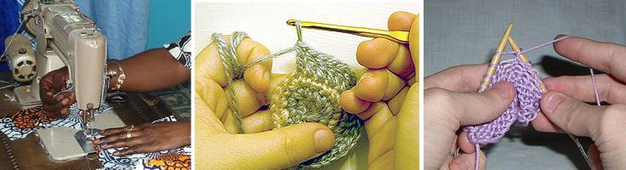
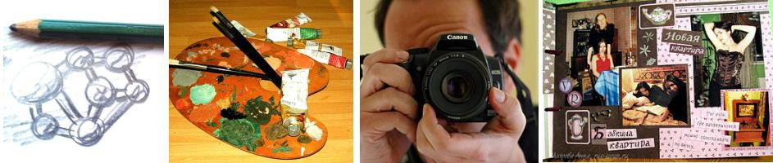
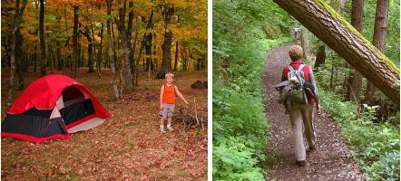
drawing / painting / photography / scrapbooking
“scrapbooking” means arranging photos in a book in an artistic way, with decorations
tinkering with electronics/computers, playing video games woodworking
making things with wood
Outdoor and athletic hobbies:
bird watching camping / hiking
gardening / fishing / hunting

Slide 7

jogging
rock climbing
sailing / surfing / water sports skateboarding
Here are some ways to talk specifically about sports and music:
"Do you play any sports?"
"Yes, I play ___ _."
"I do yoga / martial arts / pilates."
"No, I prefer working out at the gym."
"No, I'm not very athletic."
"No, but I love to watch! I'm a big fan of… [sport / team]."
"Do you play a musical instrument?"
"Yes, I play ___ _."
"I've played the piano for several years."
"I'm taking _ lessons."
"I'm in a band."
"I sing in a choir."
In the dialogue, there are two “follow-up” questions that you can use to ask for more information, after the other person tells you their hobbies:
"How'd you get into that?" (= how did you become interested in it?)
"I read an article / saw a TV show that piqued my interest."
“piqued my interest” = made me interested in learning more
"I took a class."
"I just thought it'd be interesting to try it out."
"My friend introduced me to it (and I've been doing it ever since)."
"How long have you been doing that?"
"I just started."
"For a few years." (for + time period)

Slide 8
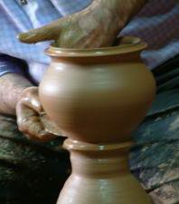
"Since I was a kid." (since + point in the past)
"Ever since I was in college."
Conversation #2 - Benefits of Hobbies
Erica’s wondering which new hobby to take up. Listen to her conversation with Natalie.
Erica: Ever since I quit my job, I’ve had a lot of time on my hands. I really need to find a new hobby.
Natalie: Well, what’s something you’ve always wanted to try? Erica: I’d love to learn how to dance… but I think I’m too shy!
Natalie: Oh, don’t let that stop you! If I had more free time, I’d definitely take dance classes. Erica: So what do you like to do for fun?
Natalie: I’ve gotten into yoga; it’s a great way to relieve stress – and a fantastic workout. And I’ve always enjoyed writing, so I’m going to start a blog.
Erica: Oh, good for you! You know, I had a ton of hobbies when I was a kid… I used to collect coins, skateboard, play chess… but none of them
really interest me anymore.
Natalie: Hey – why don’t you take up a craft like pottery, knitting, or jewelry-making? It’d be fun – and you could even sell your creations to make a little money.
Erica: That’s actually not a bad idea. I’ve always wanted to explore my artistic side.
Conversation Vocabulary & Phrases
Erica starts out by saying she has “a lot of time on her hands” – that means she has a lot of free time with nothing to do. Here are a few more phrases for talking about present, past, and potential future hobbies:
"I have a lot of time on my hands. I need to find a hobby." "I have a ton of different hobbies."
“a ton of” = a very large number of
"If I had more free time, I'd _______."
use this phrase for an imaginary situation – IF I had more free time, I WOULD…

Slide 9
"I'd like to try ________."
use this phrase to talk about something you are interested in doing, but you haven’t started yet
"I used to _________, but not anymore."
use this phrase to talk about something you did frequently in the past, but you don’t do it now
A couple of different benefits are also mentioned in the dialogue. Here are some different answers to the question of why you enjoy your hobby:
"...because it's a great workout."
= it’s good exercise
"...because it's a great way to relieve stress.” "...because it helps me clear my mind."
= it helps you forget your worries and concerns
"...because it helps me relax." “…because I find it fascinating.”
"...because it's fun/interesting/exciting/(other adjectives)." "...because I can earn a little extra money on the side."
Today’s speaking exercise is to tell me about your hobbies – talk about some hobbies you had in the past, some hobbies you have currently, and one hobby you’d like to try. Click here to record your message, and I’ll send you some tips on your speaking.

Slide 10
Session 4- Hobbies
Part 2: What would you say in the following
situations? ( More Idioms & collocations)
https://befluent.me/

Slide 11
Session 4- Hobbies
To Be Into Something
Meaning: if you’re into something, you’re really enjoying it
Example:
When I was young, I was really into my stamp collection. I took it really seriously.
He is really into his football.
To Take Up
Meaning: to begin, to start a hobby
Example:
👧 I’m bored, nobody to play with, nowhere to go.
👩‍🦳 Why don’t you take up a hobby?
After enjoying taking photographs for a few years, I’ve decided to take up photography as a serious hobby.
To Get Into Something
Meaning: to become interested in something
Example:
Many people decide to take the step to get into running each year.
Many people got into cooking during the lockdown and learnt how to make bread.
https://befluent.me/

Slide 12
Session 4- Hobbies
To Turn Up
Meaning: to arrive for an activity or event
Example:
I turn up in the gym every day, I train hard and I see results.
To Keep Up
Meaning: continue the action that we’ve started
Example:
Previously I have found it difficult to keep up going to the gym.
You have to continue to go to places to keep up your interest in photography.
To keep it up means to keep your interest alive.
To Back Out
Meaning: is the opposite of ‘keep up’, to leave, to withdraw, to lose your interest
You’re not probably too happy with the gym, the equipment is a little bit old. Maybe you don’t get along so much with the people there. So you decide to stop or to back out.
Example:
Running was really not for me so I decided to back out.
https://befluent.me/

Slide 13
Session 4- Hobbies
Part 3: Speaking Practice
https://befluent.me/

Slide 14
Session 4- Hobbies
What is a hobby?
Do you have any hobbies? What are they?
How much free time do you usually have? What do you like to do with your free time? Do you prefer be active?
Do you collect anything? If so, when did you start collecting? How large is your collection?
What kinds of things do people usually collect?
Sometimes, the things that people collect become valuable. Can you think of any examples? What ki gain the most value over time?
Do you like to learn new skills? Can you give an example of something that you have learned to do t related to your work?
Have you attended any classes to help you learn a new hobby? If not, would you like to?
Is there a hobby you are thinking about starting these days? What is it?
https://befluent.me/

Slide 15
Session 4- Hobbies
How long have you had a hobby?
Why do people have hobbies?
Why did you start your hobby?
Can you make money from doing your hobby?
How many hours a week do you spend on your hobby?
Is your hobby safe or dangerous?
What is a hobby?
Why do people need hobbies?
What can one do as a hobby?
How much time can one spend on his/her hobby?
What is your hobby?
Does your hobby interfere with your work/study/personal life?
Do you spend money on your hobby?
Does your hobby influence your choice of friends?
Can a hobby save a child from bad peer influence?
Can a hobby be dangerous?
Have you got a hobby?
How long have you had your hobby?
Which hobbies are the most expensive?
Which hobbies are the cheapest?
Which hobbies cost nothing at all?
https://befluent.me/

Slide 16
Session 4- Hobbies
Which hobbies are the most popular in your country?
Is hunting a hobby or a sport in your country?
Which hobbies are the most popular with women in your country? With men?
Did you have any hobbies when you were a child?
Can you think of any hobbies which are popular with children and adults?
Do you think a hobby is different from a sport?
Are there any hobbies you would like to try?
Are there any dangerous hobbies?
Are there any hobbies you can do in other countries, but not your own?
Which hobbies do you think are the most difficult?
https://befluent.me/

Slide 17
Session 4- Hobbies
Thank you!☺
https://befluent.me/

